Slide 1
Concepto de Mol
Sección de Imágenes.

Slide 2
https://image.slidesharecdn.com/estequiometria-130926172011-phpapp01/95/estequiometria-8-638.jpg?cb=1380216058

Slide 3
http://images.slideplayer.es/14/4357000/slides/slide_16.jpg

Slide 4
http://www.spanishdict.com/answers/181584/a-z-people-who-made-history-key-dates-/mostvotes/15/90

Slide 5
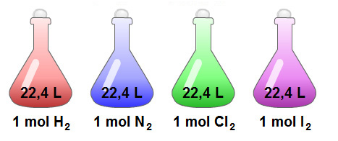
http://www.alcaste.com/departamentos/ciencias/actividades_multimedia/fqeso/actividades_qeso/masa_quimica/volumen_molar.htm

Slide 6
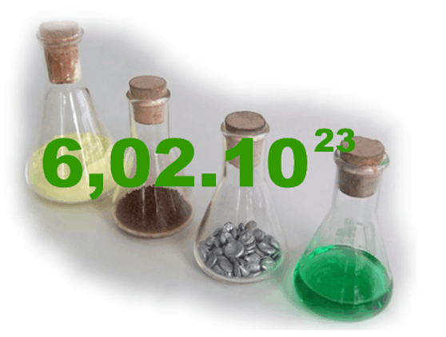
https://contentmapas.didactalia.net/imagenes/Usuarios/ImagenesCKEditor/5d1dada8-e23b-499e-aa70-66ad03aedbc4/7e845ea2-9bb3-4c6e-aa3b-dcbadd4064c6.jpg

Slide 7
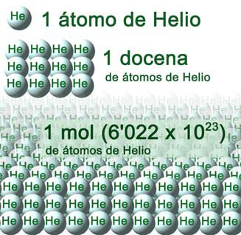
http://elpaulofreire.es/cfgs/quimica/bloque1/tema3/mol_He.jpg

Slide 8
http://4.bp.blogspot.com/-x-oD1_n7QqE/VGCwy5DZVkI/AAAAAAAAAT4/zJmXXgWtB8A/s1600/mol3.bmp

Slide 9
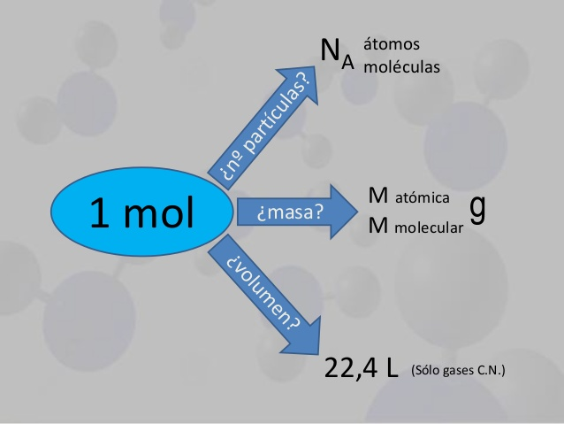

Slide 10
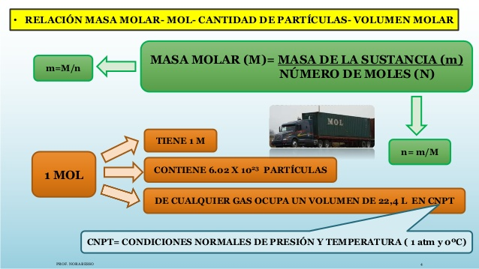
https://image.slidesharecdn.com/estequiometria-130926172011-phpapp01/95/estequiometria-8-638.jpg?cb=1380216058

Slide 11
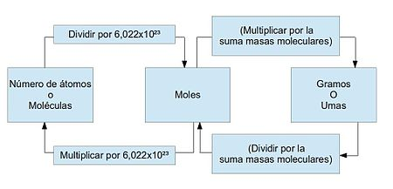
https://upload.wikimedia.org/wikipedia/commons/thumb/1/17/Conversi%C3%B3n_de_moles2.jpg/450px-Conversi%C3%B3n_de_moles2.jpg

Slide 12
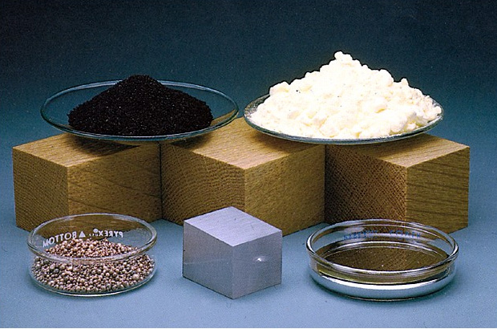
Una mol de diferentes sustancias
http://2.bp.blogspot.com/-xa0HA0JX1RU/Ug1emY2CHcI/AAAAAAAAAE8/-oGCRAOW4KQ/s1600/32FCD257A.jpg

Slide 13
Referencias de imágenes:
https://image.slidesharecdn.com/estequiometria-130926172011-phpapp01/95/estequiometria-8-638.jpg?cb=1380216058
http://images.slideplayer.es/14/4357000/slides/slide_16.jpg
http://www.spanishdict.com/answers/181584/a-z-people-who-made-history-key-dates-/mostvotes/15/90
http://image.slidesharecdn.com/new-chm-151-unit-10-power-points-140227172226-phpapp02/95/new-chm-151unit10powerpoints-51-638.jpg?cb=1393521895
http://thumb9.shutterstock.com/display_pic_with_logo/1033249/346554482/stock-vector-gases-volume-and-moles-avogadro-s-law-346554482.jpg
http://www.alcaste.com/departamentos/ciencias/actividades_multimedia/fqeso/actividades_qeso/masa_quimica/volumen_molar.htm
https://contentmapas.didactalia.net/imagenes/Usuarios/ImagenesCKEditor/5d1dada8-e23b-499e-aa70-66ad03aedbc4/7e845ea2-9bb3-4c6e-aa3b-dcbadd4064c6.jpg
https://i.ytimg.com/vi/iyJ7f6ppGaQ/hqdefault.jpg

Slide 14
http://elpaulofreire.es/cfgs/quimica/bloque1/tema3/mol_He.jpg
http://4.bp.blogspot.com/-x-oD1_n7QqE/VGCwy5DZVkI/AAAAAAAAAT4/zJmXXgWtB8A/s1600/mol3.bmp
https://image.slidesharecdn.com/estequiometria-130926172011-phpapp01/95/estequiometria-8-638.jpg?cb=1380216058
https://upload.wikimedia.org/wikipedia/commons/thumb/1/17/Conversi%C3%B3n_de_moles2.jpg/450px-Conversi%C3%B3n_de_moles2.jpg
https://upload.wikimedia.org/wikipedia/commons/thumb/1/17/Conversi%C3%B3n_de_moles2.jpg/450px-Conversi%C3%B3n_de_moles2.jpg
http://es.slideshare.net/kronologik0/03-estequiometria
http://2.bp.blogspot.com/-xa0HA0JX1RU/Ug1emY2CHcI/AAAAAAAAAE8/-oGCRAOW4KQ/s1600/32FCD257A.jpg

